Slide 1
NLP Project for disaster Tweet Classification
Presented by :
Himanshu sharma

Slide 2
Introduction
:- Develop a machine learning model that can predict whether a tweet is about a real disaster or not.
:- Create a model that can handle variations in language, including slang, abbreviations, and cultural nuances, to ensure effectiveness across diverse tweet.

Slide 3
Libraries
Import pandas as pd
Import numpy as np
Import re
import nltk
from nltk.corpus import stopwords
from nltk.stem import PorterStemmer
nltk.download('stopwords')
import TfidfVectorizer
import train_test_split
import LogisticRegression
import MultinomialNB
import RandomForestClassifier

Slide 4
Dataset Overview
Classify tweets as disaster-related or not.
Id : Unique identifier for each tweet
Keyword : Relevant disaster keyword (may be
missing).
Location : Tweet location (may be missing)
Text : Tweet content
Target : Label (1 = disaster, 0 = not disaster)

Slide 5
Sample Disaster Tweets
Show a few rows with target = 1
Highlight keywords like “fire,” “evacuation,” “flood,” etc.
Sample Non-Disaster Tweets
Show a few rows with target = 0
Emphasize unrelated topics like daily life, sports, etc.

Slide 6
Data loading and preprocessing
Text processing and feature engineering
Model building and evaluation

Slide 7
Problem facing
Missing data
Text preprocessing challenges
Imbalanced class
Label ambiguity
Short and noisy data
Model generalization

Slide 8
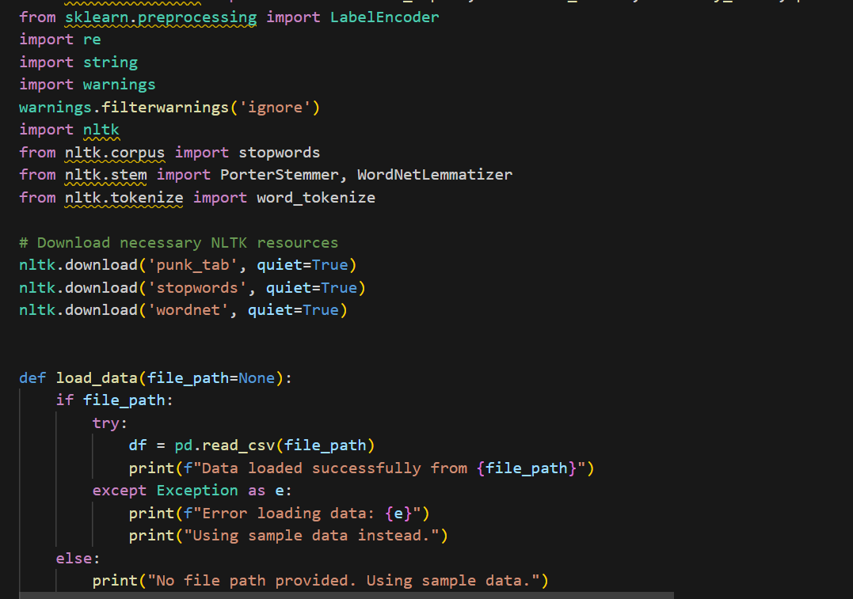

Slide 9
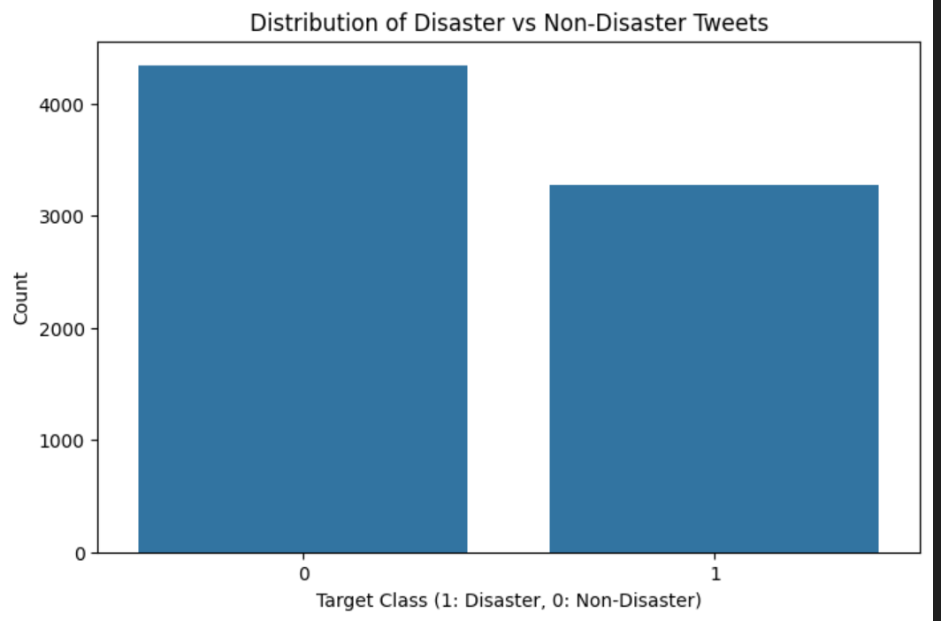

Slide 10
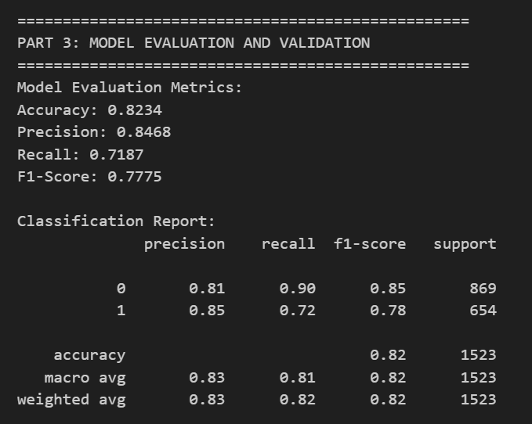

Slide 11
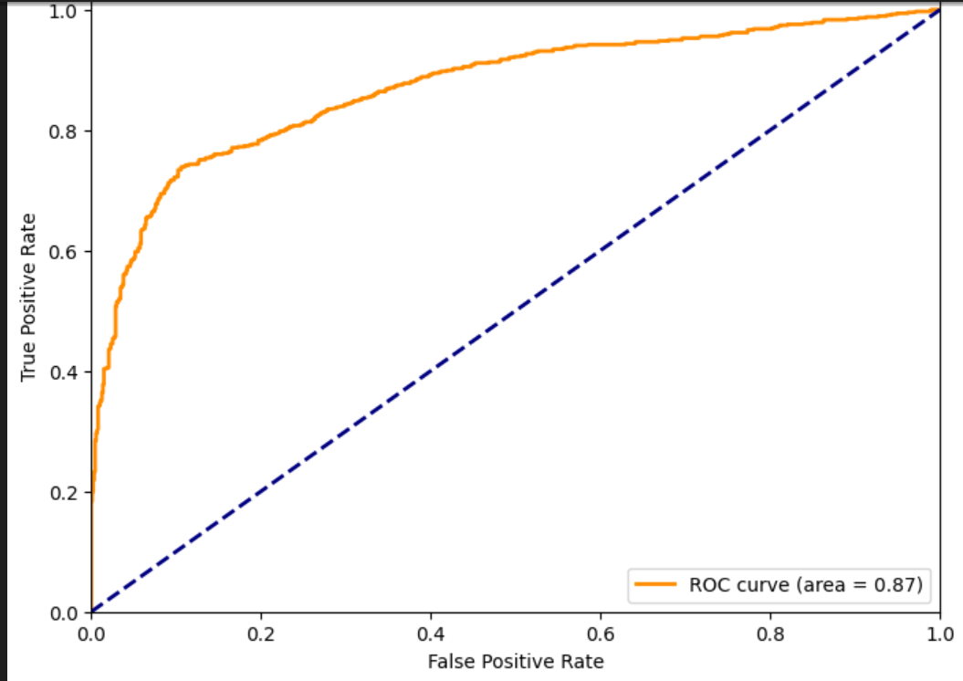

Slide 12
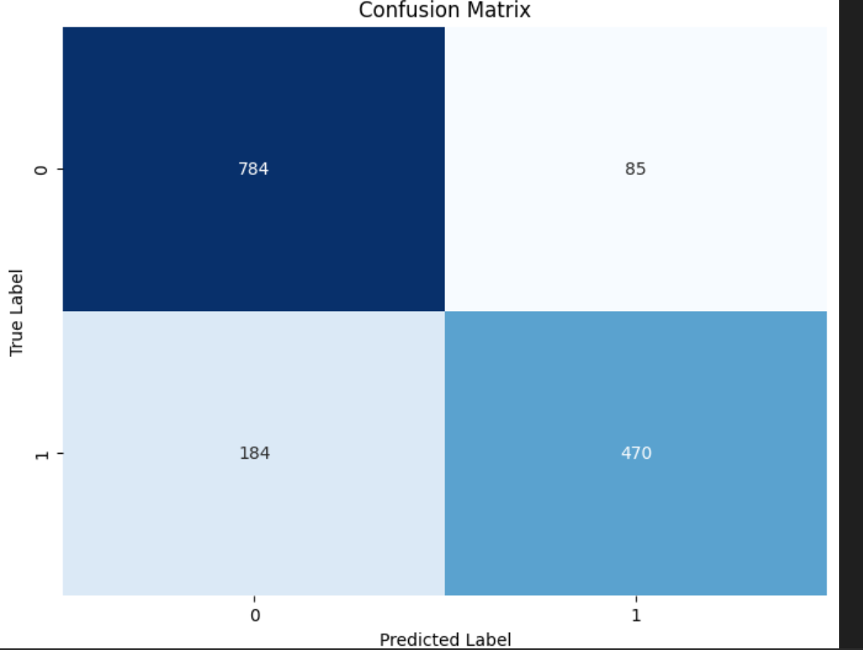

Slide 13
Conclusion
The goal of this project was to develop a model that can automatically classify whether a tweet is referring to a real disaster event or not. By leveraging natural language processing (NLP) techniques, we transformed raw tweet text into meaningful features and trained classification models to distinguish between disaster-related and non-disaster-related tweets.
Dataset Analysis: The dataset contains labeled tweets (target: 1 for disaster, 0 for not). Tweets span various types of disasters such as wildfires, floods, earthquakes, and heatwaves.
Preprocessing: Text data was cleaned by removing stop words, lowercasing, and tokenization. Hashtags, punctuation, and special characters were also handled.

Slide 14
Modeling: Several classification algorithms were evaluated, such as Logistic Regression, Naive Bayes, and Random Forest, with performance assessed via accuracy, F1 score, and confusion matrix.
Performance: The best-performing model achieved high accuracy in distinguishing disaster-related tweets from general or casual ones.

Slide 15
Thank you

